Slide 1
COVID-19
By: William donnell-lonon, ben tutka, colin partridge, Gabe rivera

Slide 2
Overview & Context
COVID-19 started to spread late 2019
Entered US early 2020
Amounted to 2nd highest per-capita death tolls of any nation, highest total (reported) death toll.
Many regional disparities, age-based risks, and contributing conditions factor into death toll

Slide 3
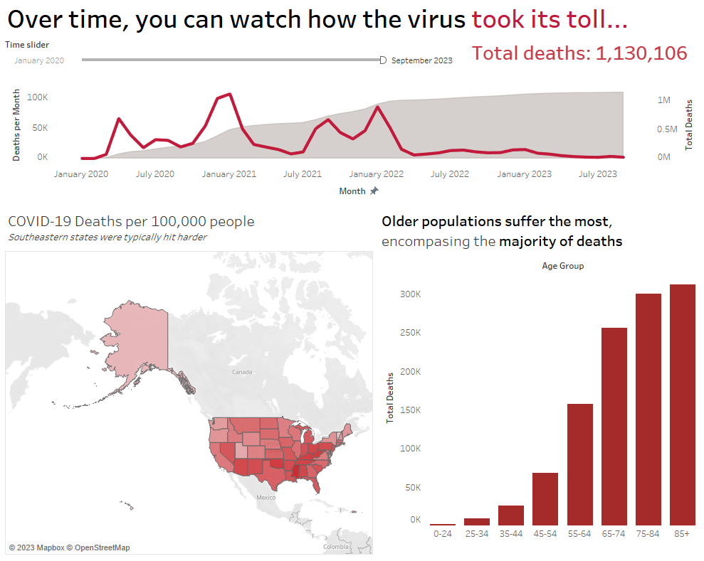
COVID-19 Deaths by State/Age
- The majority of COVID deaths occur in older populations
- Per-capita death tolls higher in the south (vaccine hesitance, loose regulations, lower income)
- Big monthly peaks in January (post-holiday gatherings, cold/flu season)

Slide 4
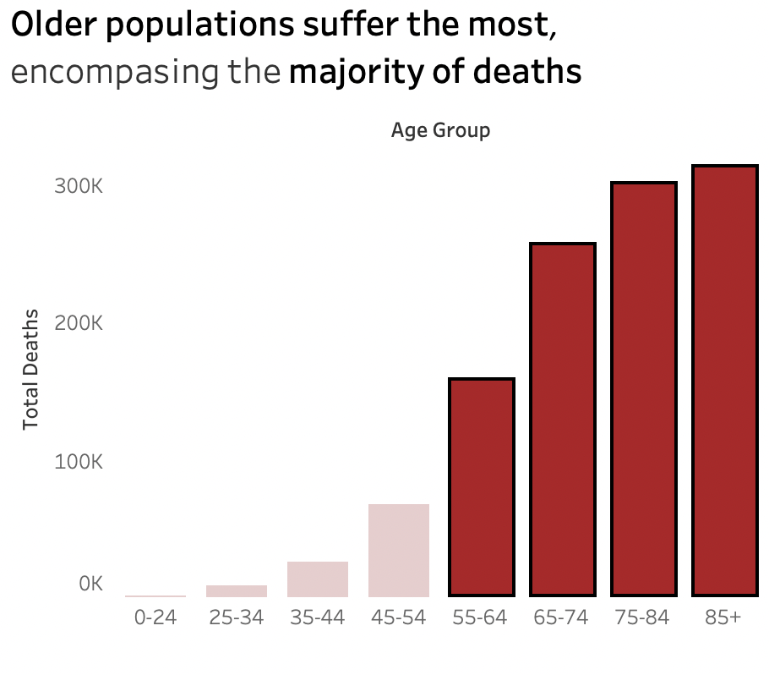
COVID-19 Deaths by State/Age
- The majority of COVID deaths occur in older populations
- Per-capita death tolls higher in the south (vaccine hesitance, loose regulations, lower income)
- Big monthly peaks in January (post-holiday gatherings, cold/flu season)

Slide 5
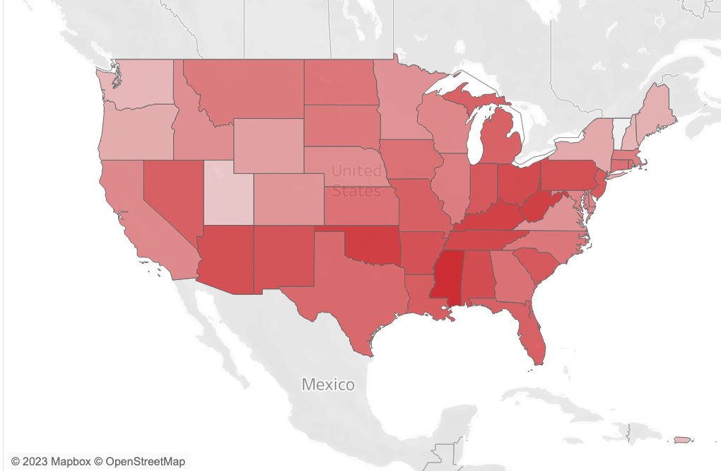
COVID-19 Deaths by State/Age
- The majority of COVID deaths occur in older populations
- Per-capita death tolls higher in the south (vaccine hesitance, loose regulations, lower income)
- Big monthly peaks in January (post-holiday gatherings, cold/flu season)

Slide 6
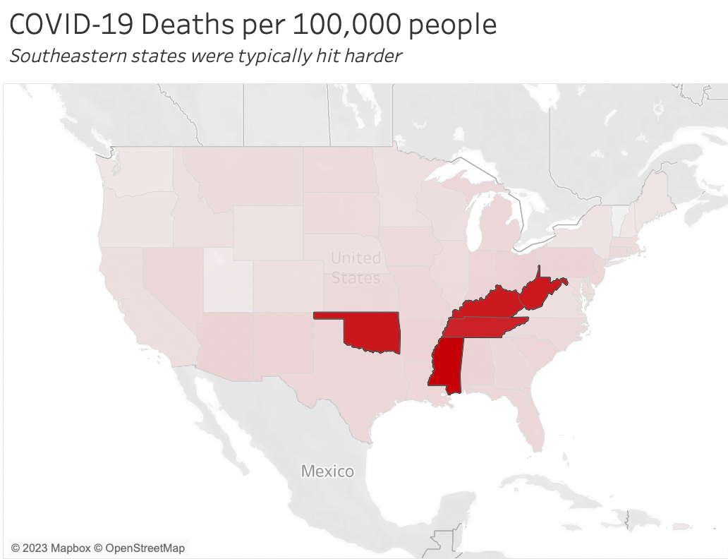
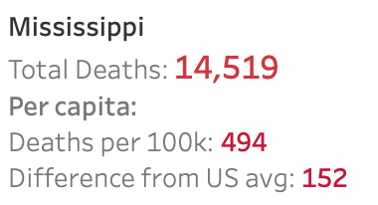
COVID-19 Deaths by State/Age
- The majority of COVID deaths occur in older populations
- Per-capita death tolls higher in the south (vaccine hesitance, loose regulations, lower income)
- Big monthly peaks in January (post-holiday gatherings, cold/flu season)

Slide 7
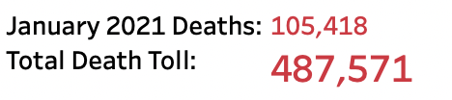
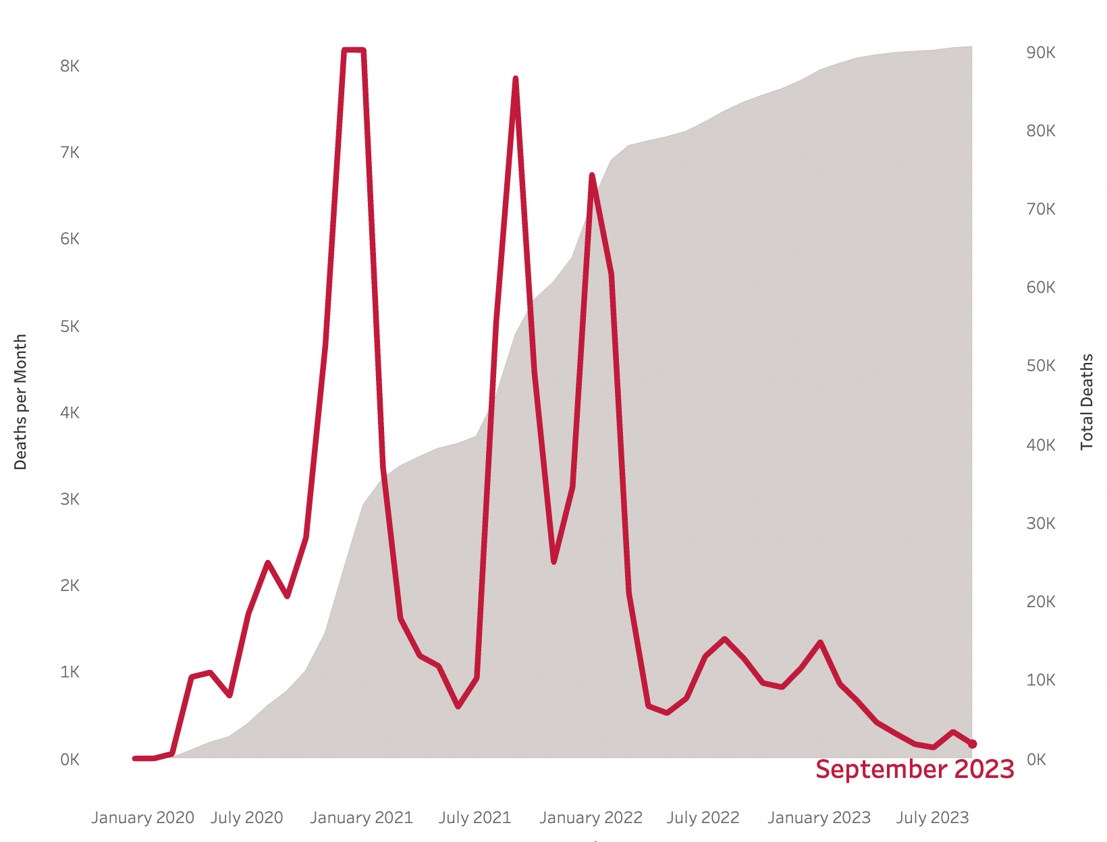
COVID-19 Deaths by State/Age
- The majority of COVID deaths occur in older populations
- Per-capita death tolls higher in the south (vaccine hesitance, loose regulations, lower income)
- Big monthly peaks in January (post-holiday gatherings, cold/flu season)

Slide 8
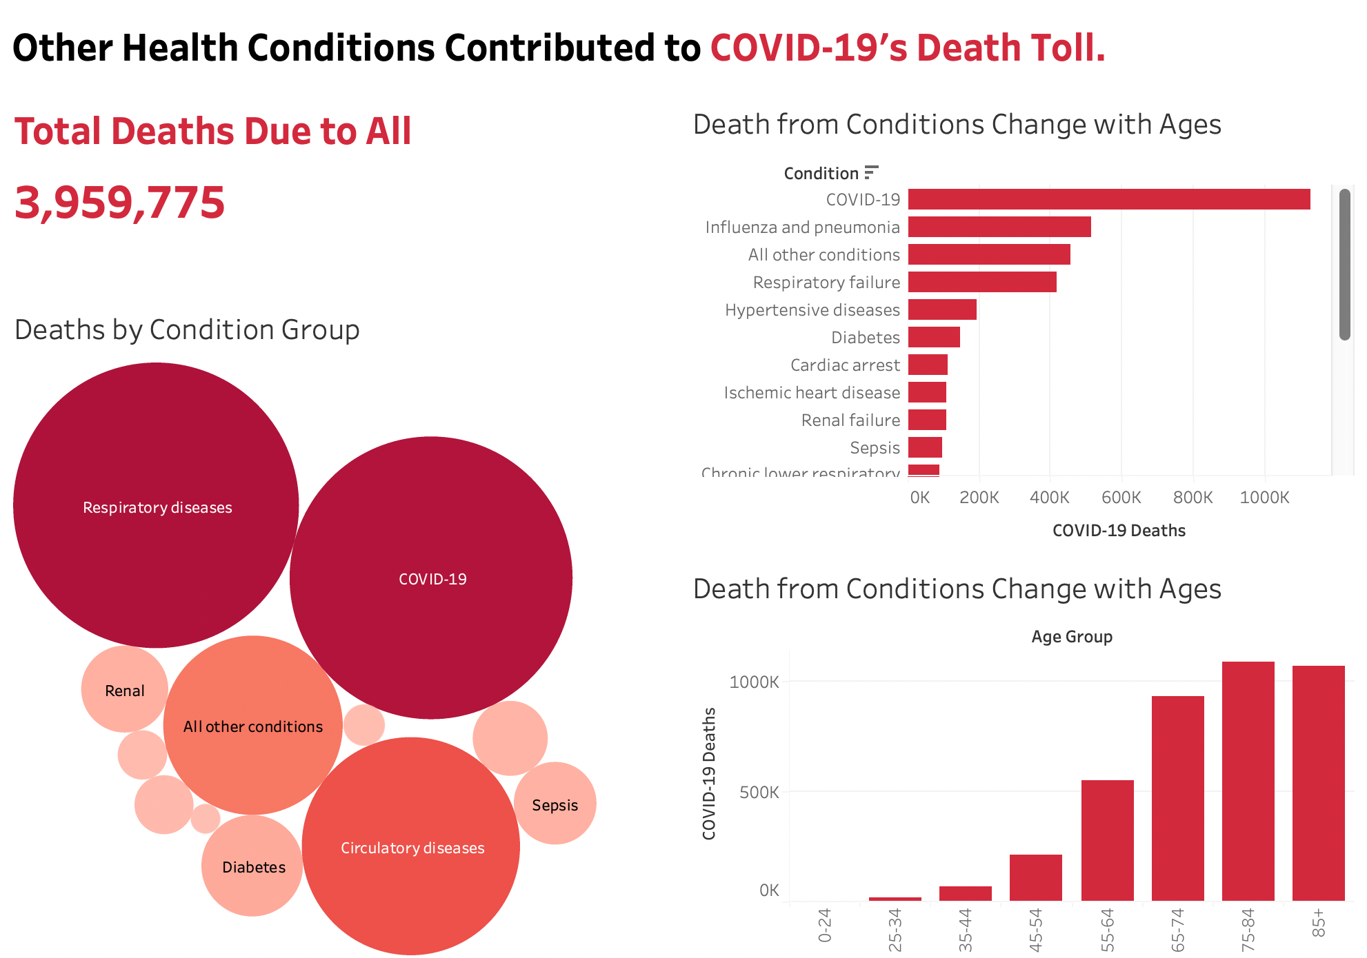
Conditions Contributing to COVID-19
COVID had high comorbidities with Respiratory diseases and circulatory diseases
Older generations more susceptible to health problems
Conditions were distributed unevenly across age groups (Alzheimer’s & Dementia contributed to the deaths of no-one younger than 65)

Slide 9
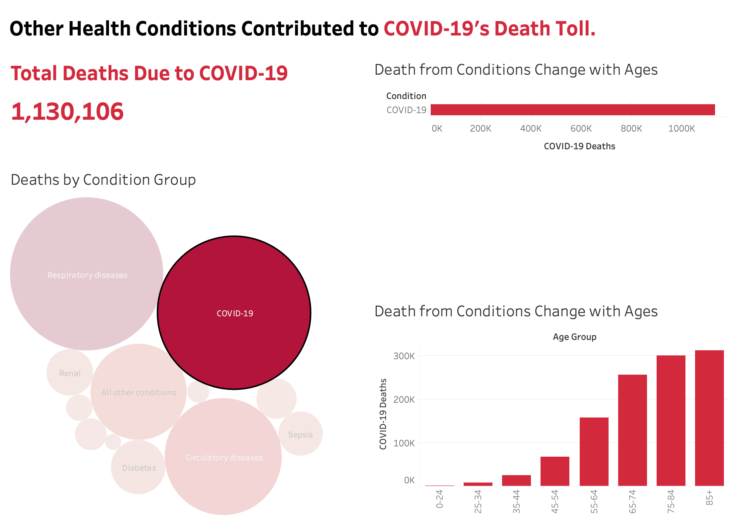
Conditions Contributing to COVID-19
COVID had high comorbidities with Respiratory diseases and circulatory diseases
Older generations more susceptible to health problems
Conditions were distributed unevenly across age groups (Alzheimer’s & Dementia contributed to the deaths of no-one younger than 65)

Slide 10
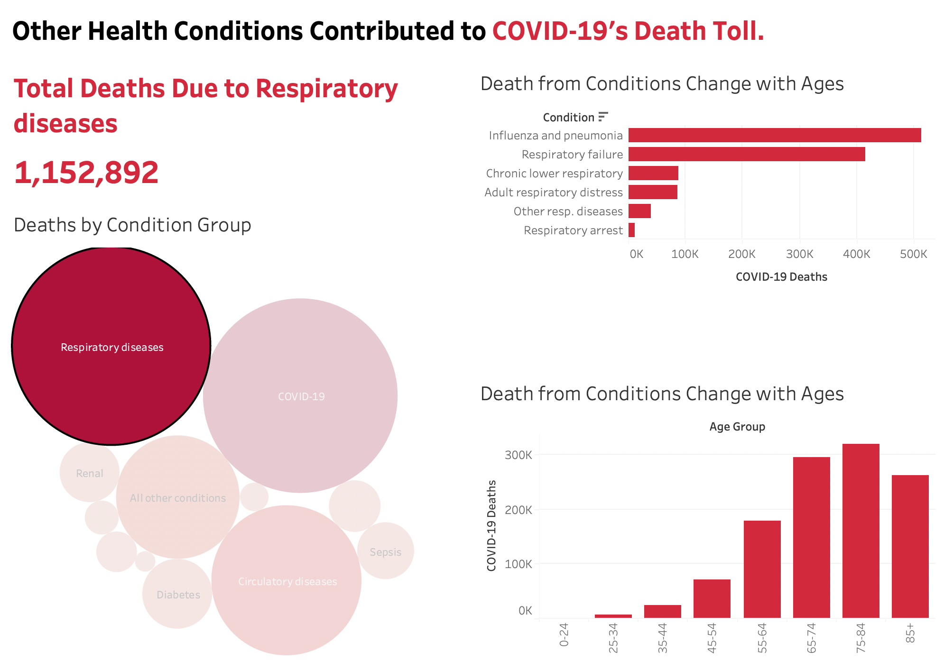
Conditions Contributing to COVID-19
COVID had high comorbidities with Respiratory diseases and circulatory diseases
Older generations more susceptible to health problems
Conditions were distributed unevenly across age groups (Alzheimer’s & Dementia contributed to the deaths of no-one younger than 65)

Slide 11
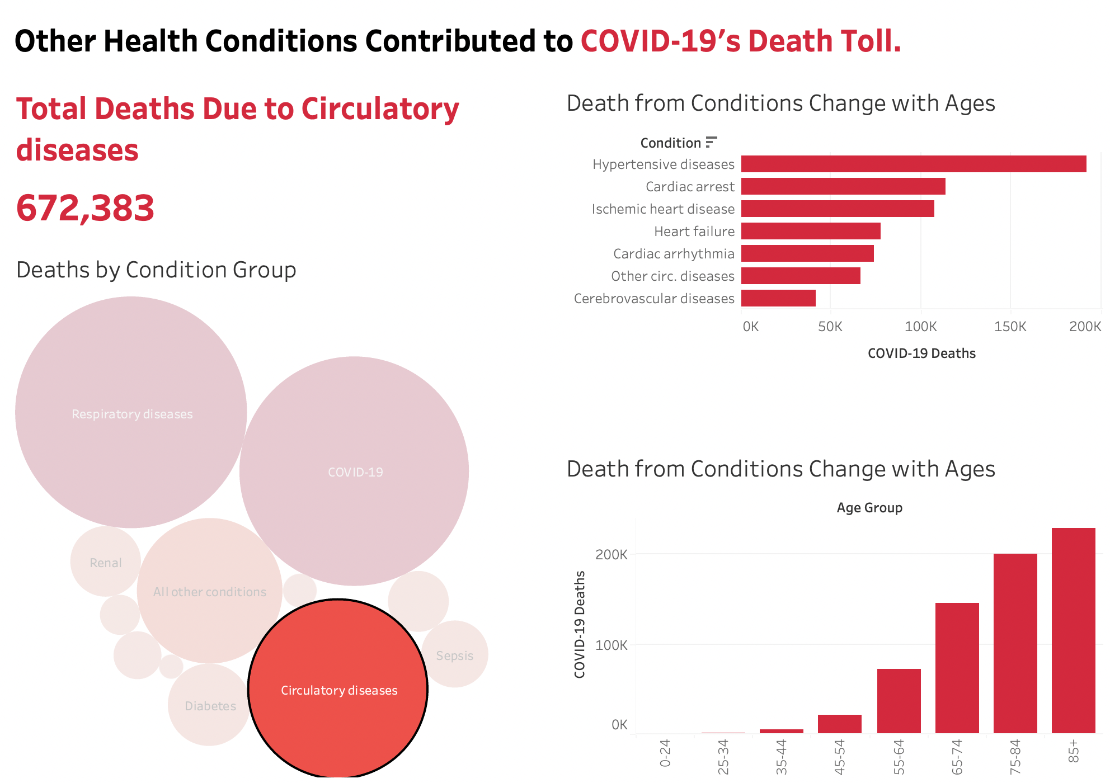
Conditions Contributing to COVID-19
COVID had high comorbidities with Respiratory diseases and circulatory diseases
Older generations more susceptible to health problems
Conditions were distributed unevenly across age groups (Alzheimer’s & Dementia contributed to the deaths of no-one younger than 65)

Slide 12
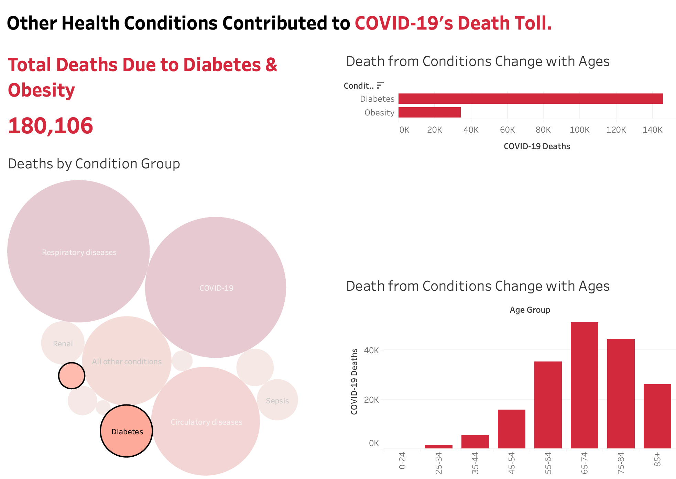
Conditions Contributing to COVID-19
COVID had high comorbidities with Respiratory diseases and circulatory diseases
Older generations more susceptible to health problems
Conditions were distributed unevenly across age groups (Alzheimer’s & Dementia contributed to the deaths of no-one younger than 65)

Slide 13
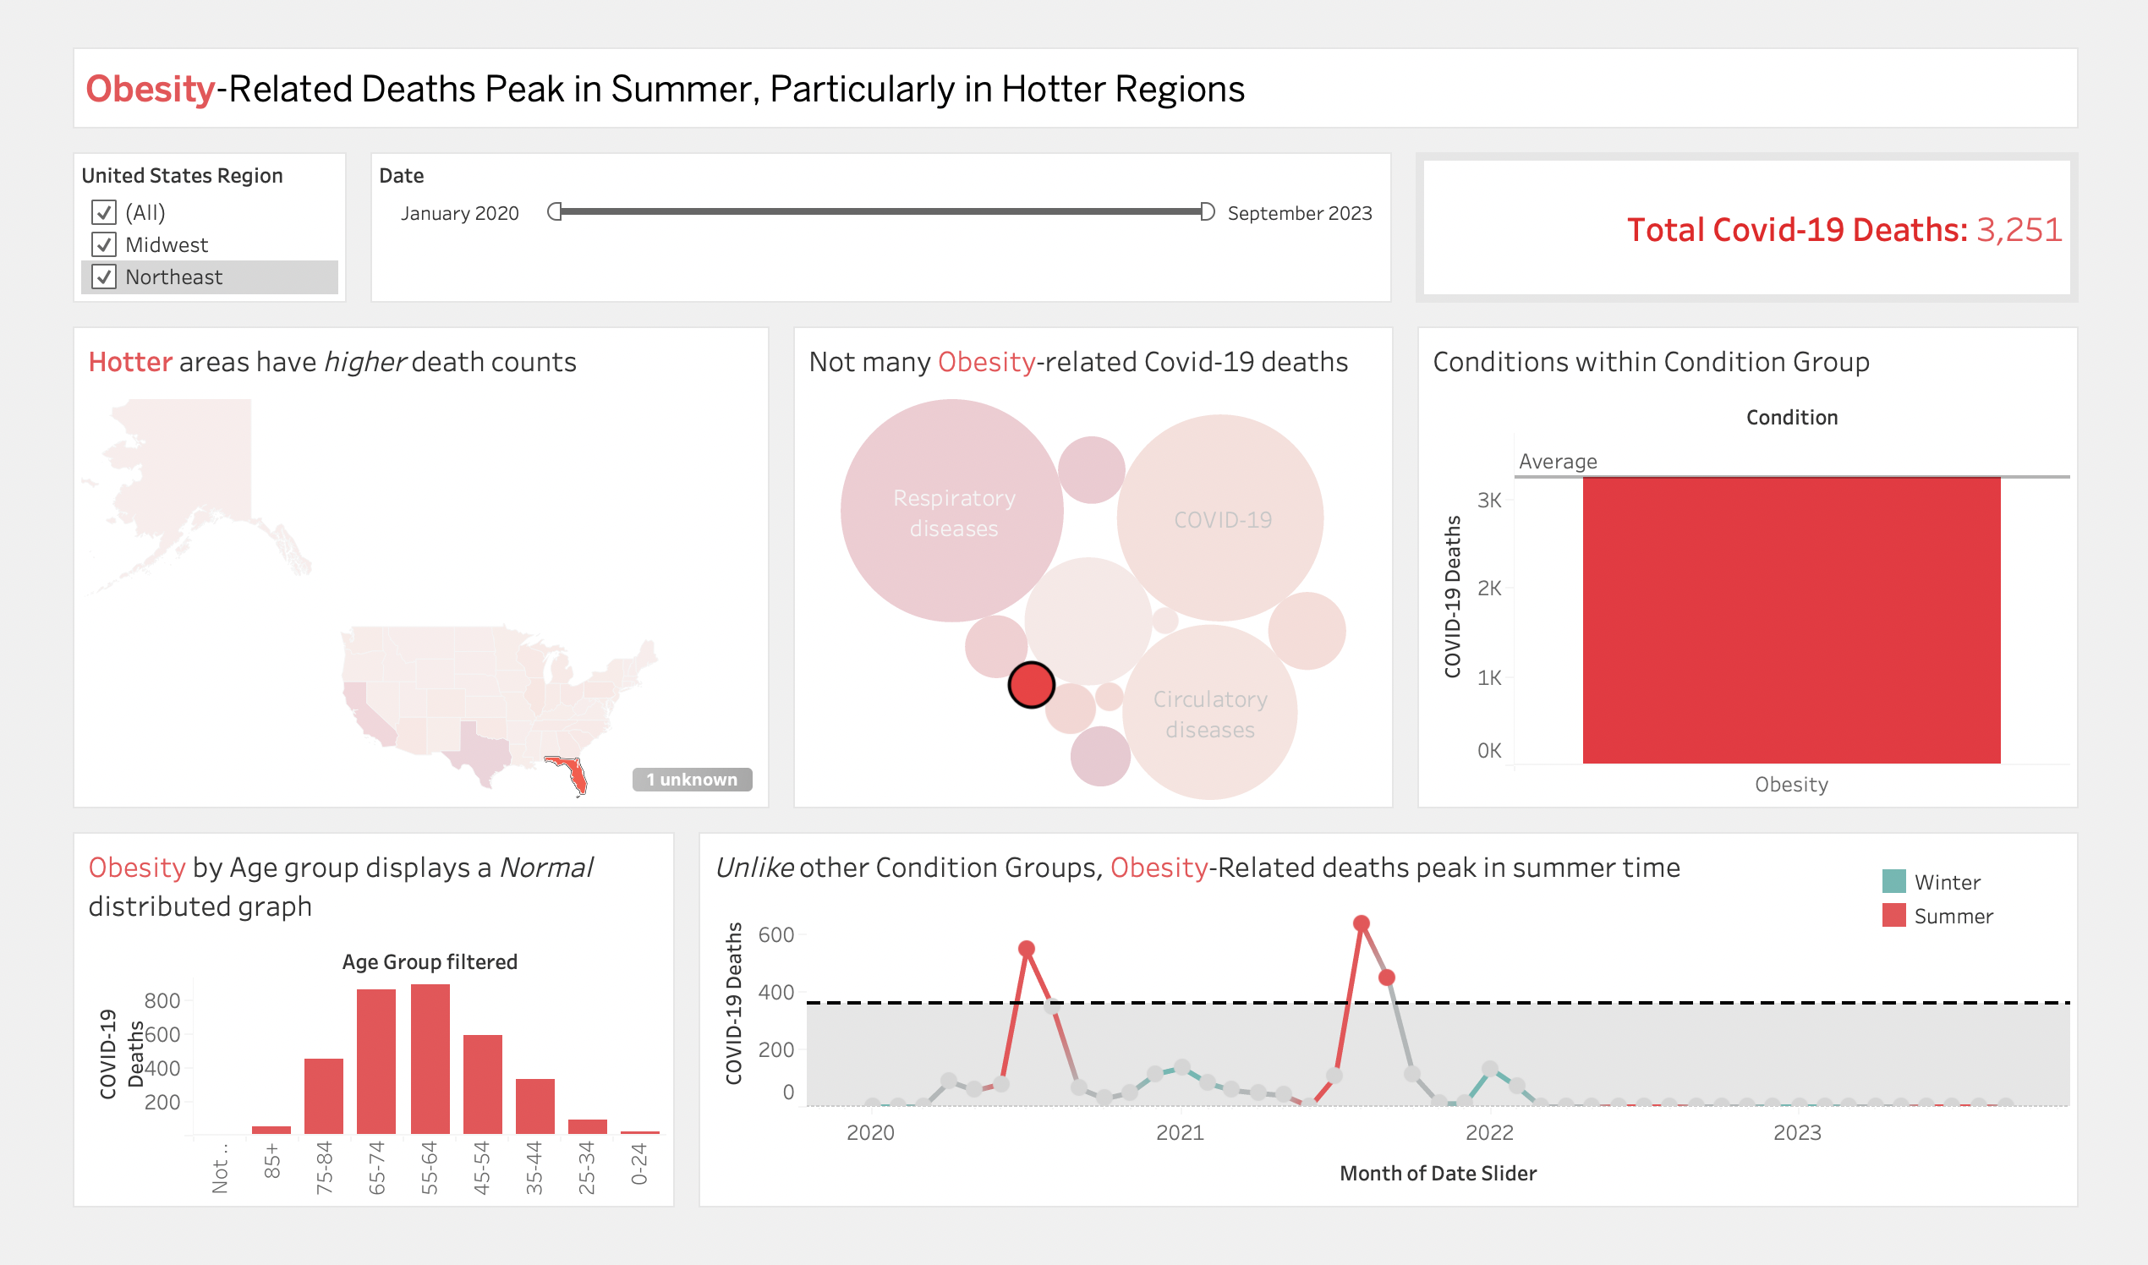
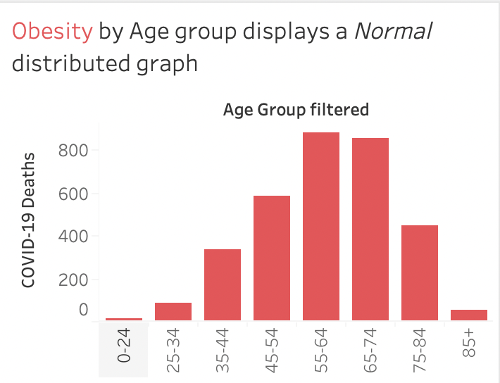
Conditions Contributing to COVID-19 continued
Unlike other Conditions, Obesity-Related Covid Deaths Peaked in Summer
States that experience warmer weather have higher Obesity-Related Covid Deaths
A small percentage of Covid-19 deaths are Obesity-Related
Obesity's Covid-19 Death chart per age group is Normally distributed

Slide 14
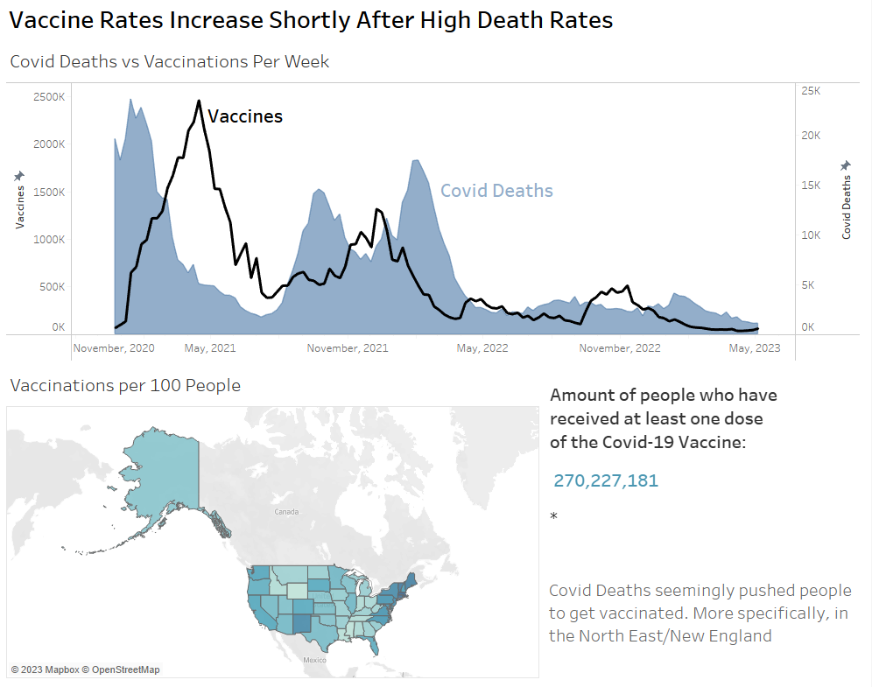
COVID-19 Vaccinations/Deaths
'People Vaccinations' followed 'COVID Deaths' pattern for the most part just a few months apart.
Vaccinations per 100 people show how the Northeast has higher vaccination rates while the Southeast has among the lowest.
A couple of states, Connecticut and Massechusetts, had over 100 vaccines per 100 people. This data was from the CDC...

Slide 15
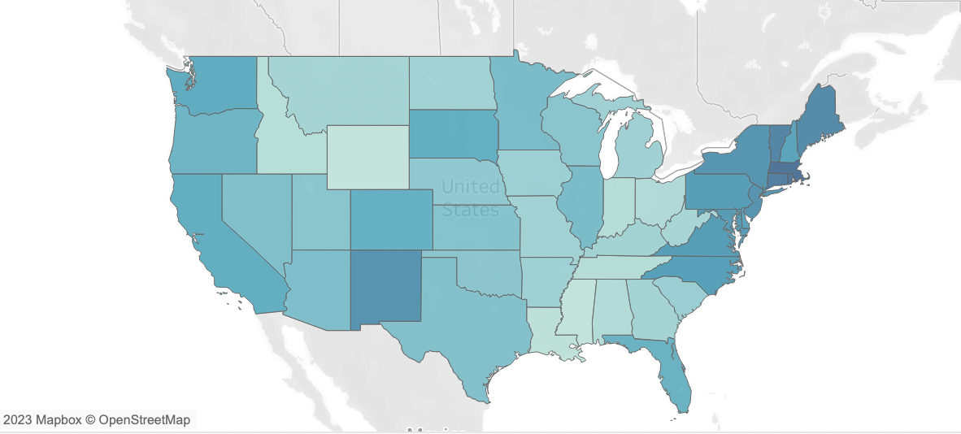
COVID-19 Vaccinations/Deaths
'People Vaccinations' followed 'COVID Deaths' pattern for the most part just a few months apart.
Vaccinations per 100 people show how the Northeast has higher vaccination rates while the Southeast has among the lowest.
A couple of states, Connecticut and Massechusetts, had over 100 vaccines per 100 people. This data was from the CDC...

Slide 16
Results/Conclusions
Southeastern states less vaccinated, higher death toll
Old populations significantly more at-risk
Winter months (January specifically) have high peaks
Comorbidities add to death toll (respiratory, cardiovascular)
Vaccine rates increase shortly after death rates
Overall death rates have recently dropped off

